Slide 1


WATCH MAIL IN THE WAY YOU WANT

Slide 2


Project Idea:
The goal is to create a web-based application that users may access from any location. The application primarily targets larger enterprises and smaller organizations who deal with many mails every day. Given that the application has a form with attributes like
The customer's organization's mail id and password (we even can provide same as service if we deal with security for the credentials).
One dropdown for collecting the information regarding the format user wants to convert.
We also collect the timestamp from which we want to convert the mails into the format we want to change.
And finally, the submission button.

Slide 3

Methodology and why
Agile Methodology
Since we had first intended to construct the application as a web service, we changed our minds after carefully considering the requirements. In order to improve access to the services offered in the online application, new services in addition to mail converter have been introduced as time goes on. We therefore applied agile methods.

Slide 4
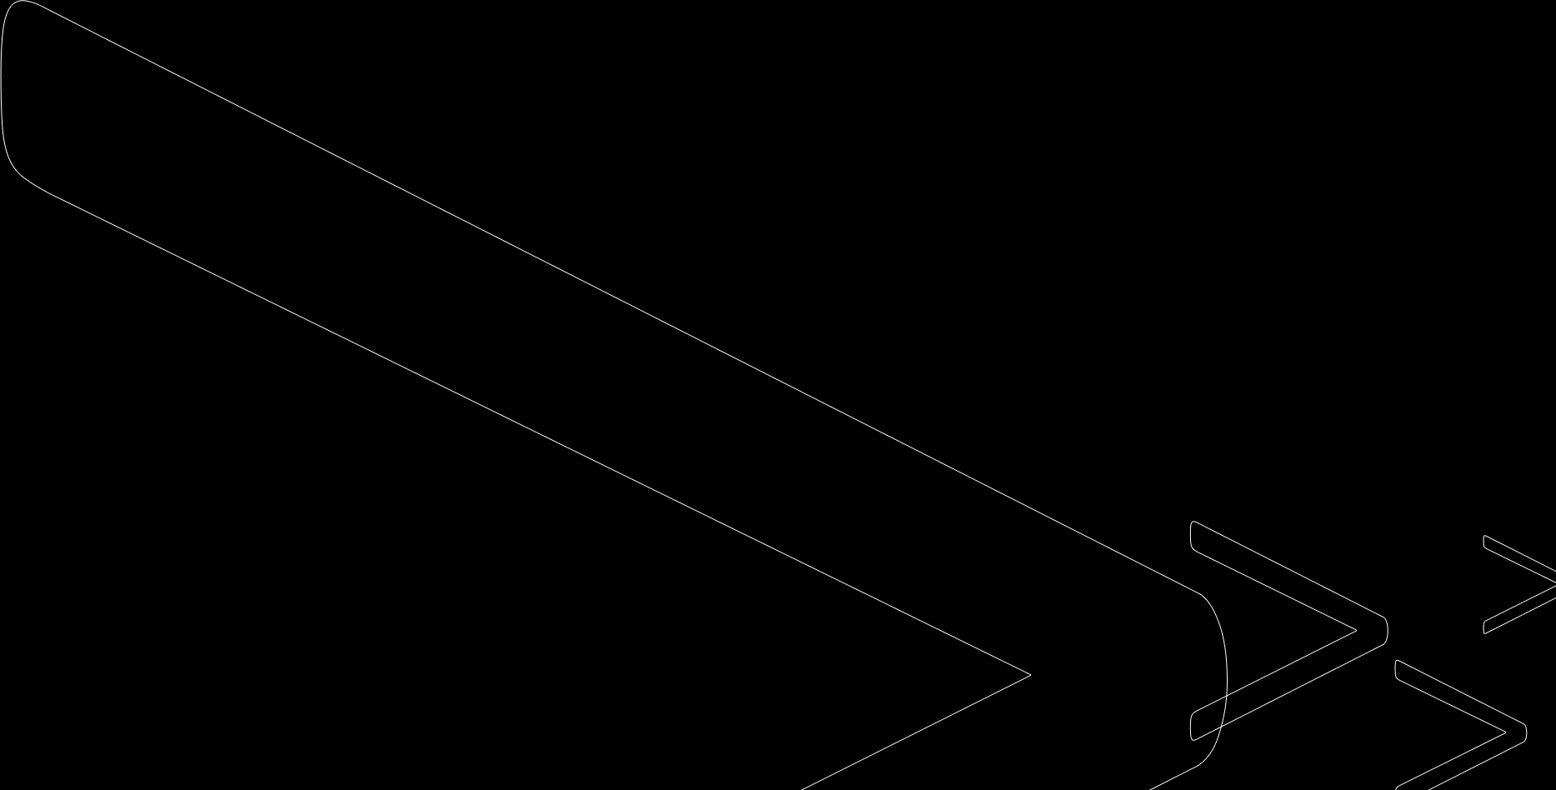
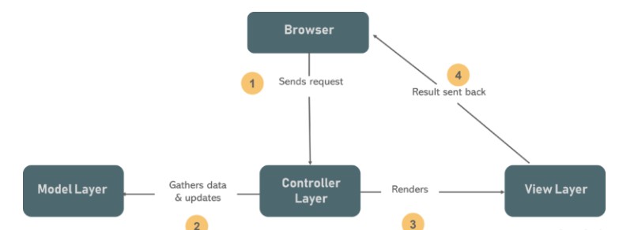
MVC

Slide 5

Project Requirements:
Develop a sample MVC application with installing all extensions as follows:
1. .NET 4.5 C# MVC
2. Entity Framework 6.0.0
3. Bootstrap 5.4.1
4. Html
5. CSS
6. JavaScript

Slide 6
Sprint Breakdown
z

Slide 7

Sprint 1
UserStory1. 1: Gathering information for analysis and requirements.
UserStory1.2: Making Environment ready like Information related to extensions for the project that support the following technologies:
1. .NET 4.5 C# MVC
2. Entity Framework 6.0.0
3. Bootstrap 5.4.1
4. Html
5. CSS
6. JavaScript
7. Git

Slide 8
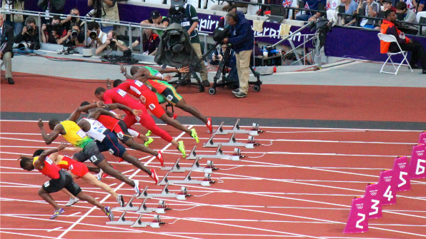
Sprint 2
We need to develop UI for the Login Page.
UserStory2. 1: Which includes building the Login form,
UserStory2. 2: Creating a model to the Login Form,
UserStory2. 3:Controller to validate the data for Login details
This Photo by Unknown author is licensed under CC BY.

Slide 9
User Story2.1
Name | Login UI
Trigger | On opening the URL or Onclick Logout
Script | We need to create a web form for the Login UI, Which contains fields like: Email Id (Type for this fields should accept with xyz@abc.com) Password (Type for this fields should accept password) Buttons Like: Login (Navigate to Login action in Home Controller) Register (Navigate to Register action in Home Controller)
z

Slide 10
User Story2.2
Name | Model for Login UI
Trigger | On Login button click
Script | We need to create a database table for web form for the Login UI, Which contains columns like: Email Id (Type for this fields should accept with xyz@abc.com) Password (Type for this fields should accept password) Organization Name
z

Slide 11
User Story2.3
Name | Controller for Login UI
Trigger | On Login
Script | We need to create an action method which returns the same Login Page if the model is not valid or Need to return Home Index if the model is valid.
z

Slide 12
Requirements
NR1: Installing all extensions for application(To make application portable and scalable)
Goal: Should be able run an empty application with all the necessary folders
Description: Should be able to show an empty web page without any error and supports below technologies: NET 4.5 C# MVC, Entity Framework 6.0.0, Bootstrap 5.4.1, Html, CSS, JavaScript
Origin: According to the requirements and Team discussion
Version: 1.0 Date: 09/26/2022 Priority: 1

Slide 13
Requirements
NR2: Setup code repository in Git (Version Control)
Goal: Should be able handle the different versions of code
Description: We should be able to use the code repository created in the Git, every time we make changes to the code by taking latest from the code repository.
Origin: For avoiding confusion with version control.
Version: 1.0 Date: 09/26/2022 Priority: 1

Slide 14
Requirements
FR1: Registration Form for User Interface
Goal: Should be able to show all fields related to Register form without any error
Description: Register page contains Organization Name, Email ID, Password and Submit button.
Origin: User should have a subscription account
Version: 1.0 Date: 09/3/2022 Priority: 1

Slide 15
Requirements
FR2: Creation of a data model for Register form
Goal: Create a model which contains fields related to Register form and be able to store the user registered data in the form of table.
Description: Model means we need to create a database table in the entity framework for storing the details related to subscriber registration which contain field like Organization Name, Email Id, Password.
Origin: To validate the details in the origin page
Version: 1.0 Date: 09/3/2022 Priority: 1

Slide 16
Requirements
FR3: Login UI
Goal: Should be able to login with the subscription details without any error
Description: UI page should contain fields to enter like Email Id, Password. Buttons like login and register.
Origin: To access the services provided to the subscription
Version: 1.0 Date: 09/3/2022 Priority: 1

Slide 17
Requirements
FR4: Home Page UI
Goal: To show the details of the subscriber once login
Description: Home page contains details like subscriber Mail Id, Organization Name and the button like AddEmails and Logout.
Origin: Able to show the services the subscriber had access too.
Version: 1.0 Date: 09/3/2022 Priority: 1

Slide 18
Requirements
FR5: Add Mails UI
Goal: Should be able to add emails to the subscriber ID.
Description: Add email UI contains Fields like subscriber ID, sub email, password, confirm password along with buttons like GO To Home and keep on adding mail to the subscriber.
Origin: For accessing emails.
Version: 1.0 Date: 09/3/2022 Priority: 1

Slide 19
Requirements
FR6: Creation of Model for Add Mails
Goal: Should be able to store the Mails data in the model.
Description: This model contains details like subscriber ID, sub email and password
Origin: Details for Mail converter
Version: 1.0 Date: 09/3/2022 Priority: 1

Slide 20
Requirements
FR7: Convert email UI
Goal: should be able to convert inbox emails to the format choosen and in the location specified.
Description: should be able to select time interval, email id from the dropdown, the format from the dropdown, location to store and submit button. On the proper selection of the fields
Origin: To convert the emails.
Version: 1.0 Date: 09/3/2022 Priority: 1

Slide 21
Usecase
Usecase Name | Need to develop a web form for register
Related Requirements | FR1, FR2
Goal in Context | Should be able to get all the details for the parameters needed to pass through the register form and be able to save it in the Entity Framework tables
Preconditions | All the details in the form are required.
Successful End Condition | It will save all the details of the form like: Email Id Password(Encrypted) Organization Name
Failure | Could not be able to store the User details if Email already existed or any fields are empty.
Failed End Condition | The application will not return to Login page(after event), when we click on register due to model issues.
Primary Actor | Server
Secondary Actor | User
Trigger | The Administrator request the CMS to create a web form for the user
Main Flow | When a user try to Login, He/she might not have access as they have not yet registered. We will place Register button in the login page, So that user can create account for our service.

Slide 22
Usecase
Usecase Name | Need to develop a web form for Login Page
Related Requirements | FR3
Goal in Context | Should be able to get all the details for the parameters needed to pass through the Login form and be able navigate to home page, if the model is valid.
Preconditions | It will produce all the details related to the format chosen for Login page and will pass details to the server to cross validate the form.
Successful End Condition | It will return to the home page, if the model is valid
Failure | It will return to the Login page, if the model is not valid
Failed End Condition | The application does not navigate to home and shows the same login page on wrong details entered.
Primary Actor | User
Secondary Actor | Server
Trigger | The Administrator request the CMS to create a web form for the user
Main Flow | The Admin asks the system to create a web form. The user request to enter the information for the required fields.

Slide 23
Usecase
Usecase Name | Need to create service to convert Mail to html format likewise
Related Requirements | FR7
Goal in Context | A new/existing user requests the server to convert the mail to html format(given format in the form).
Preconditions | The user need to enter the format details in which format mail need to convert.
Successful End Condition | User requested format in the web form will be displayed in the output(Ex: Html, Java Script)
Failure | Could not be able to produce any output files.
Failed End Condition | The application to develop service to convert mail to html format is rejected.
Primary Actor | Server
Secondary Actor | User
Trigger | The user request the CMS to convert the mail in the mentioned format.
Main Flow | The user enter the information to which the mail need to convert in the web form. The user request the server to change the given format. The user is able to view the requested format successfully.

Slide 24
Usecase
Usecase Name | Need to create the validations for all the attributes
Related Requirements | FR1,FR2,FR3,FR4,FR5,FR6,FR7
Goal in Context | A new/existing user information need to verify for all the attributes requests the web form to enter the required fields from the administrator.
Preconditions | The system is limited to recognize authorized user. So the authorized user needs to have appropriate proof of identity.
Successful End Condition | User details able to validate for all the attributes.
Failure | Could not be able to produce any output files.
Failed End Condition | The created service to verify all the attributes is rejected.
Primary Actor | Administrator.
Secondary Actor | User, Service
Trigger | The User request the service to validate all the attributes mentioned in the form.
Main Flow | The user request to enter the information for the required fields. The service validates the provided information of all the attributes present in the form.

Slide 25
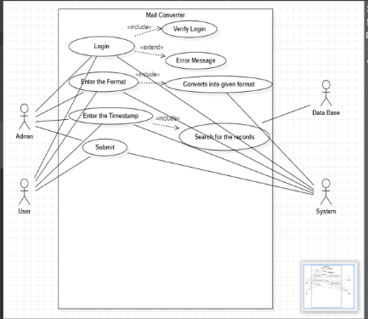
Use case Diagram

Slide 26
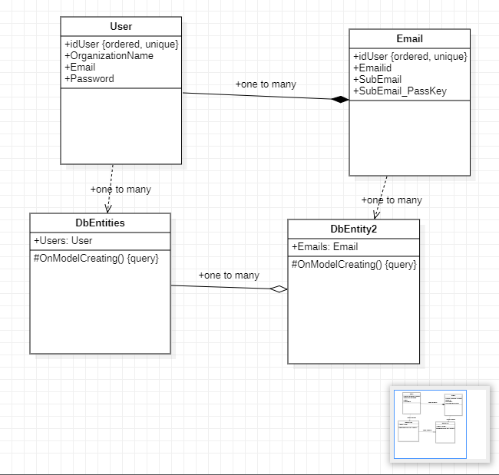
Class Diagram

Slide 27
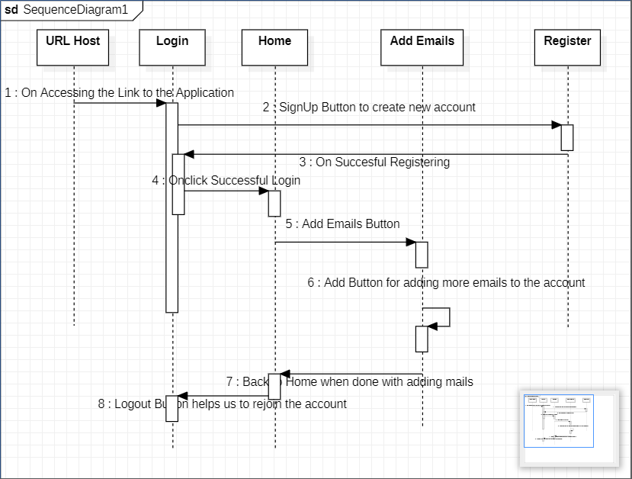
Sequence Diagram

Slide 28
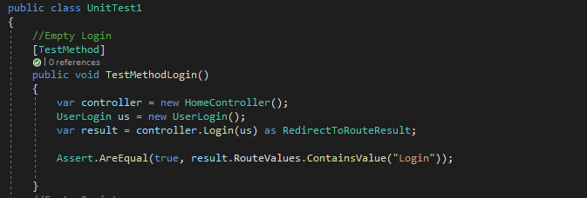
Testcases

Slide 29
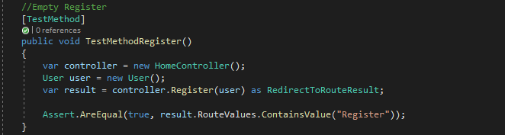
Testcases

Slide 30
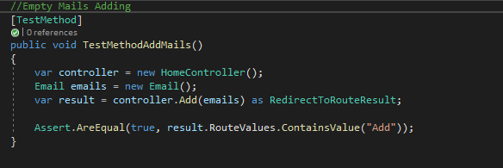
Testcases

Slide 31
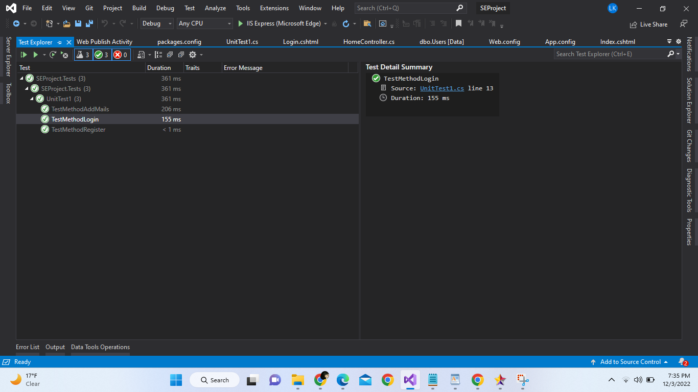
Failed End Condition:
The created service to verify all the attributes is rejected.
Primary Actor: Administrator.
Secondary Actor: User, Service.
Trigger:
The User request the service to validate all the attributes mentioned in the form.
Main Flow:
The user request to enter the information for the required fields.
The service validates the provided information of all the attributes present in the form.

Slide 32
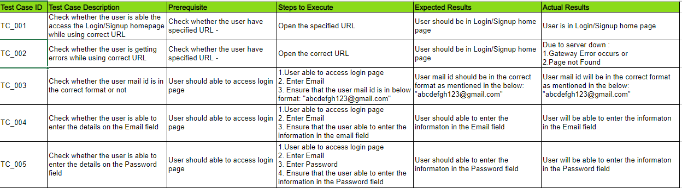
Manual Testcases

Slide 33
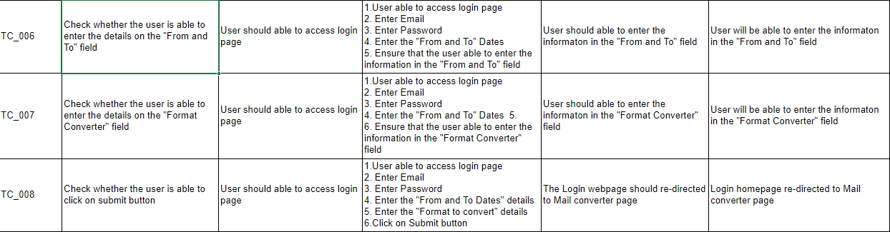
Manual Testcases

